Slide 1


A Python-based Dynamic Weather Forecaster & To-Do List
WeatherBot

Slide 2
Introduction
Jon Guilez – UI/UX Designer
Nick Harshey – Documenter
Angel Carillo - Debugger
Jayson Coleman – Backend Developer

Slide 3

The Problem & Solution
To-do apps ignore weather; weather apps don’t suggest tasks
People go out unprepared
Last-minute plan changes
Missed opportunities on great weather days
Our Solution:
Built with Python, Tkinter, NWS API, VS Code, and GitHub
Combines weather forecasts with daily planning
Suggests tasks and attire based on conditions
One unified interface for weather + tasks

Slide 4

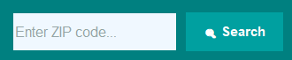
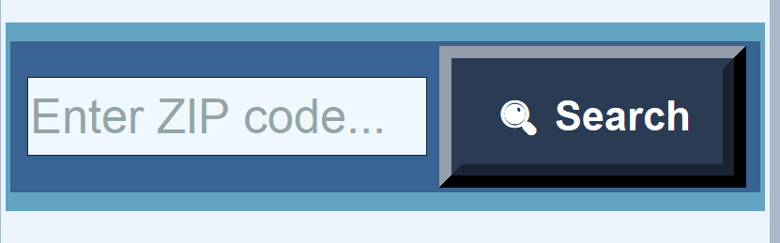

The Journey
Core Foundation
Built initial application structure in python
Created functional GUI with TKinter
Connected weather data with task management
Built smart suggestion engine
Allowed the users to search using ZIP codes instead of coordinates
Refined all user interactions
Conducted usability testing
Fixed bugs and optimized performance
Integrated the National Weather Service API allowing users to fetch weather data any where in the USA with their GPS coordinates
Visually updated to the software with new search bars, fonts, color scheme

Slide 5
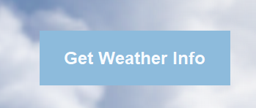
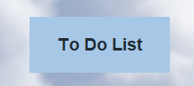
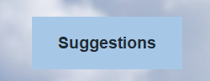
Key Features
ZIP code location search
Live Forecasts from the National Weather Service
Accurate location-based data
Temperature and conditions
Add, edit, and complete daily tasks
Organize by indoor vs outdoor
Integration with weather data
Weather-aware daily recommendations
Proactive alerts for conditions
Personalized planning assistance

Slide 6

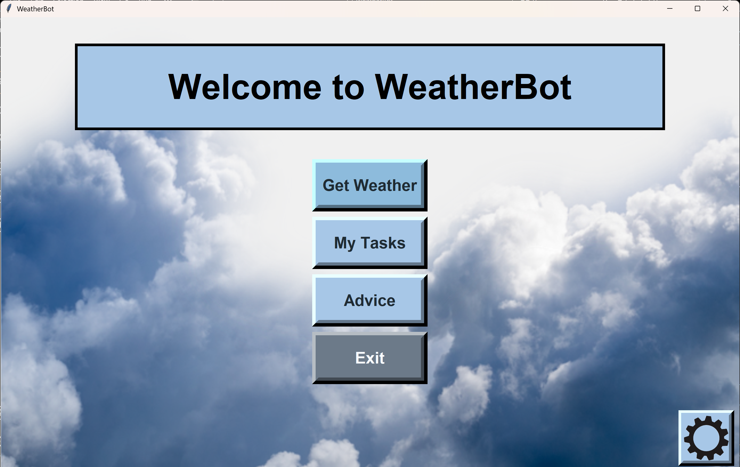
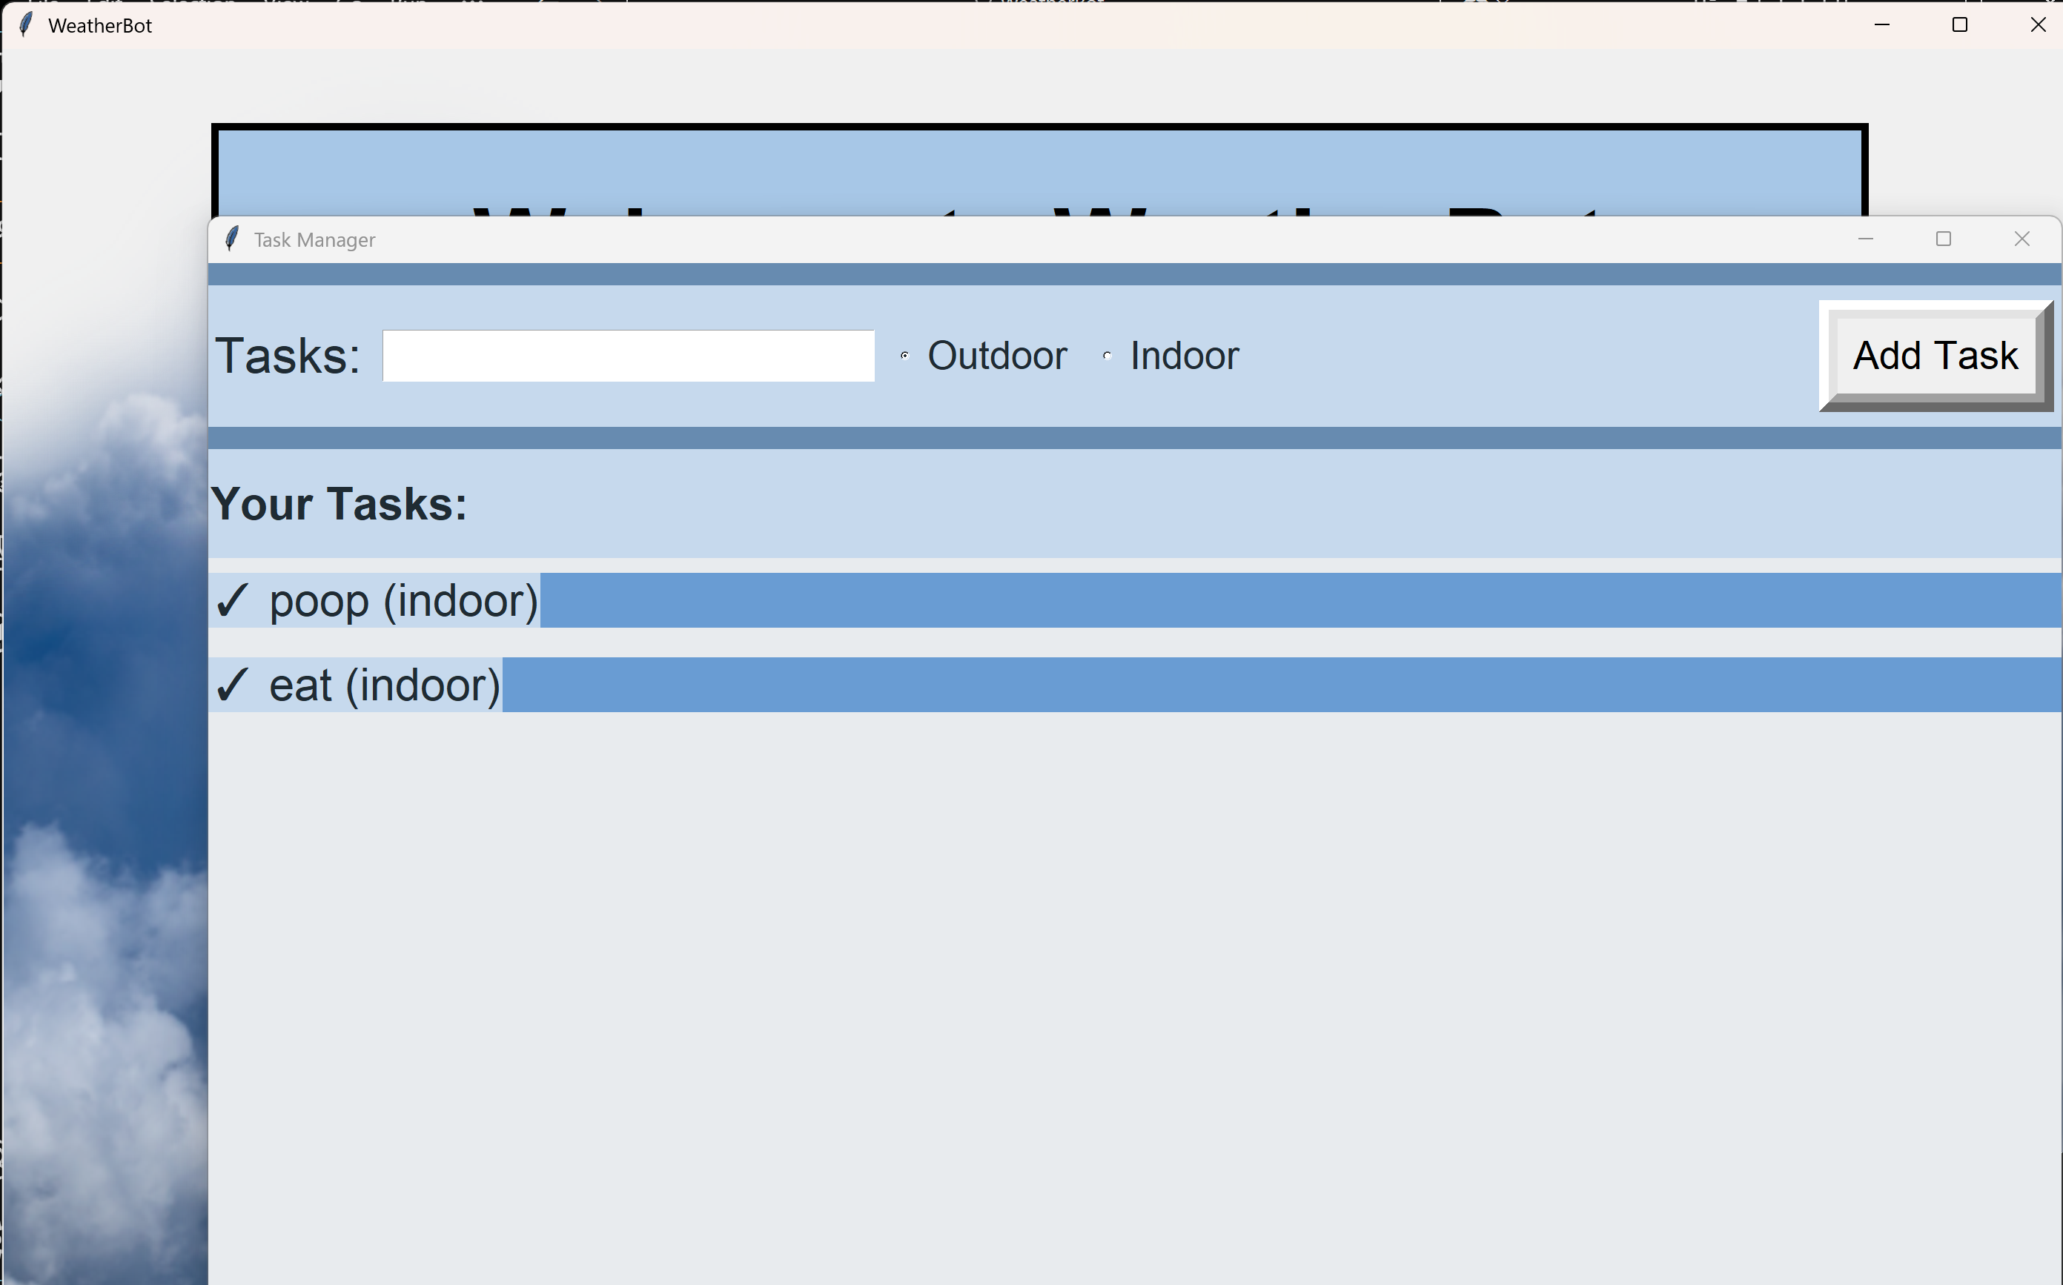
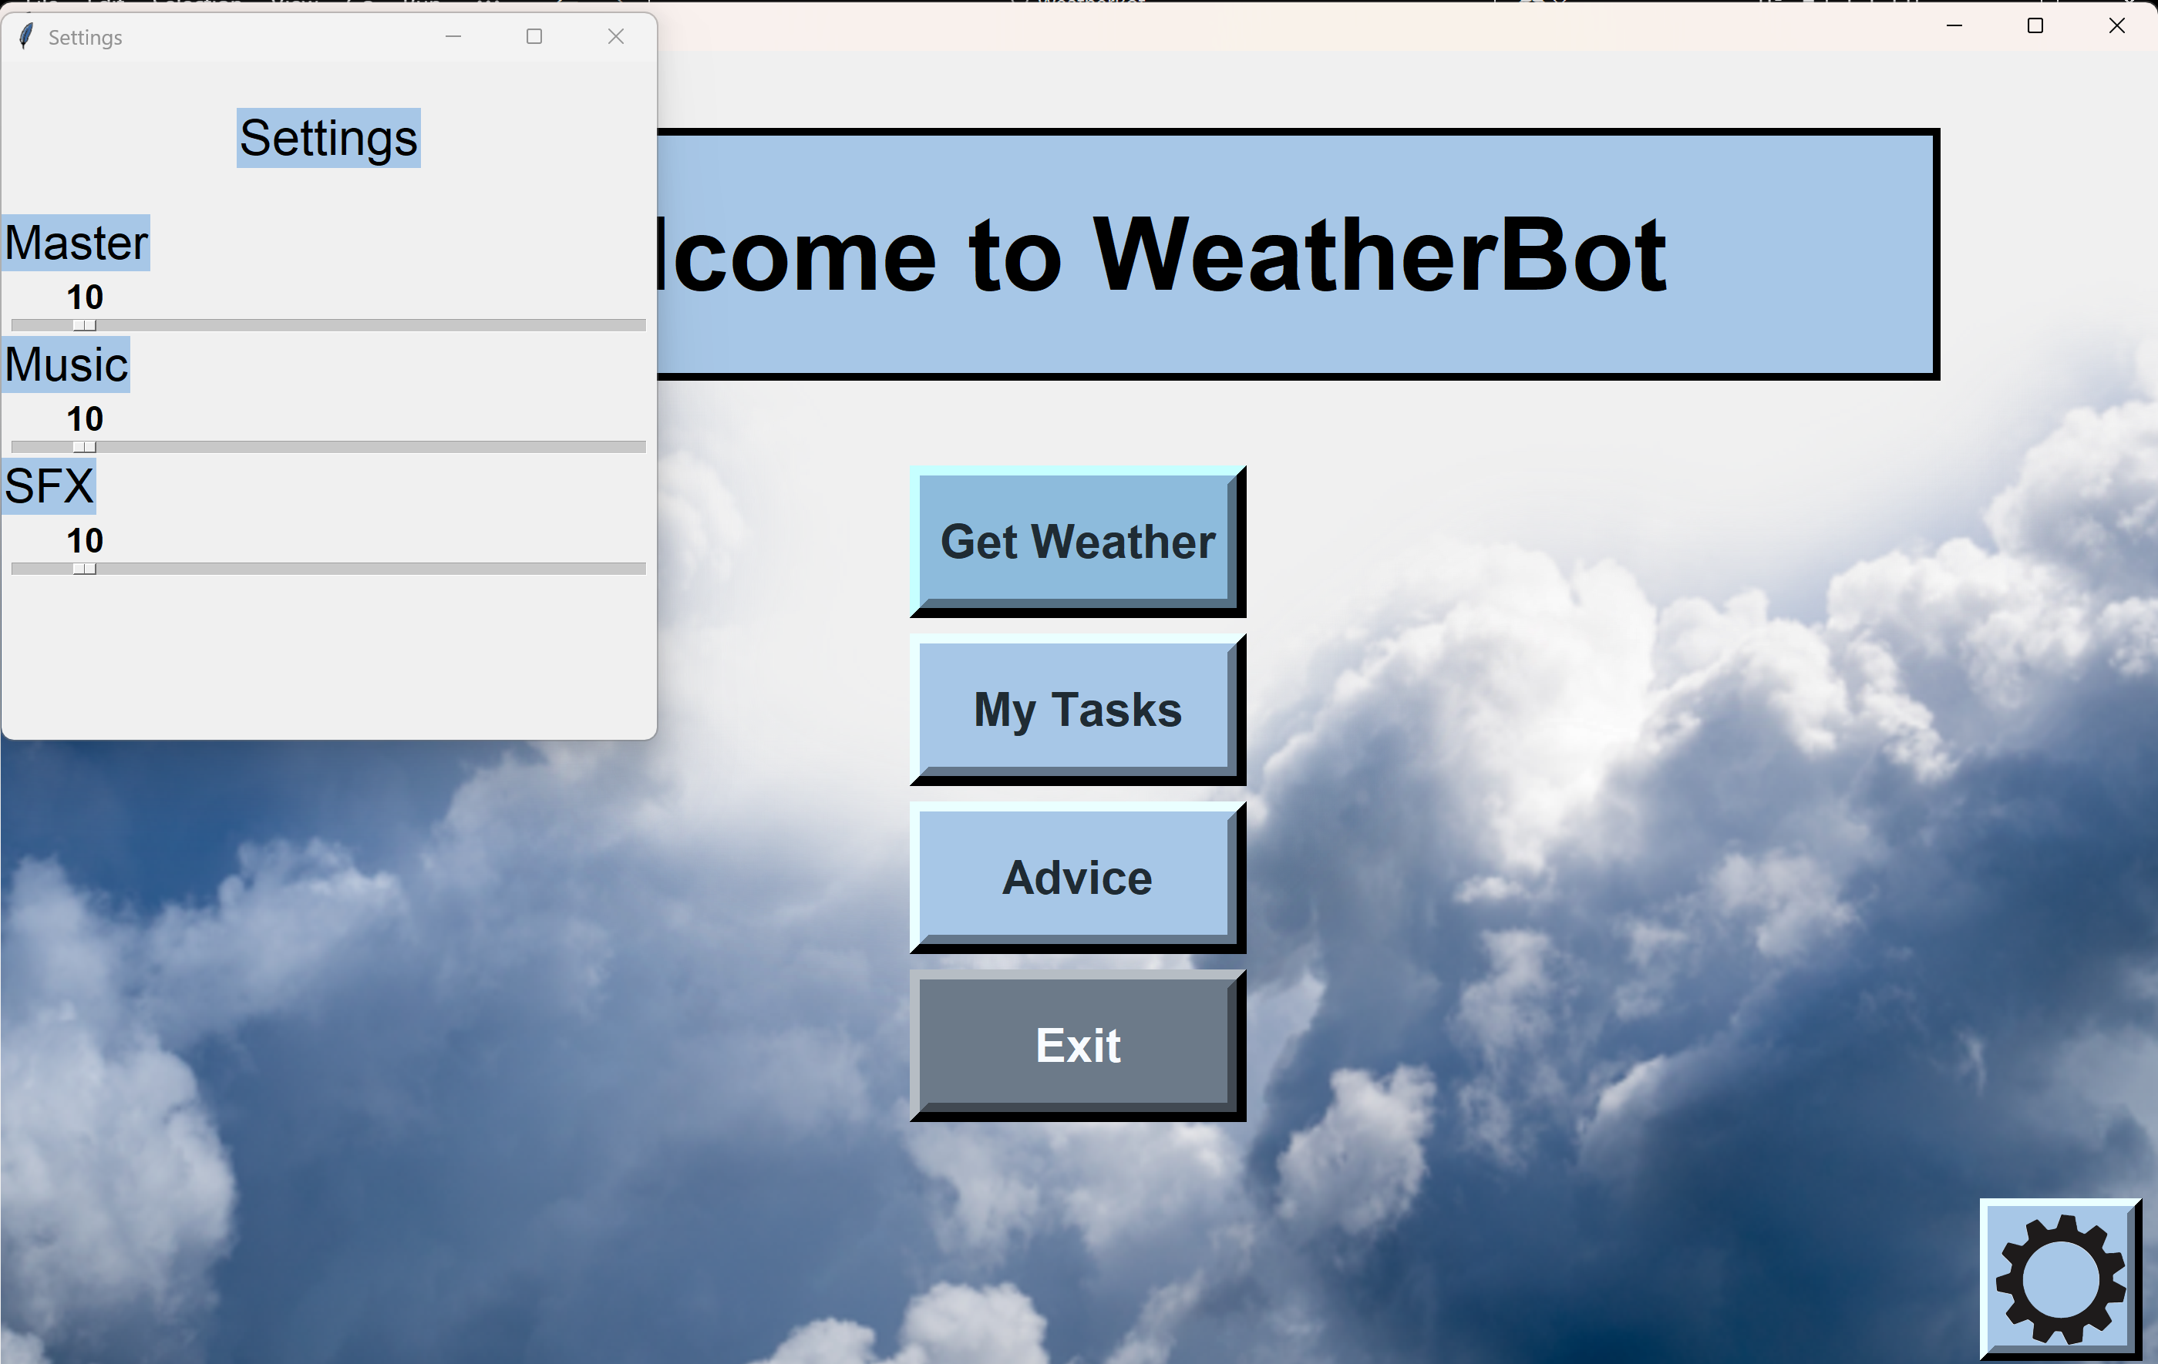
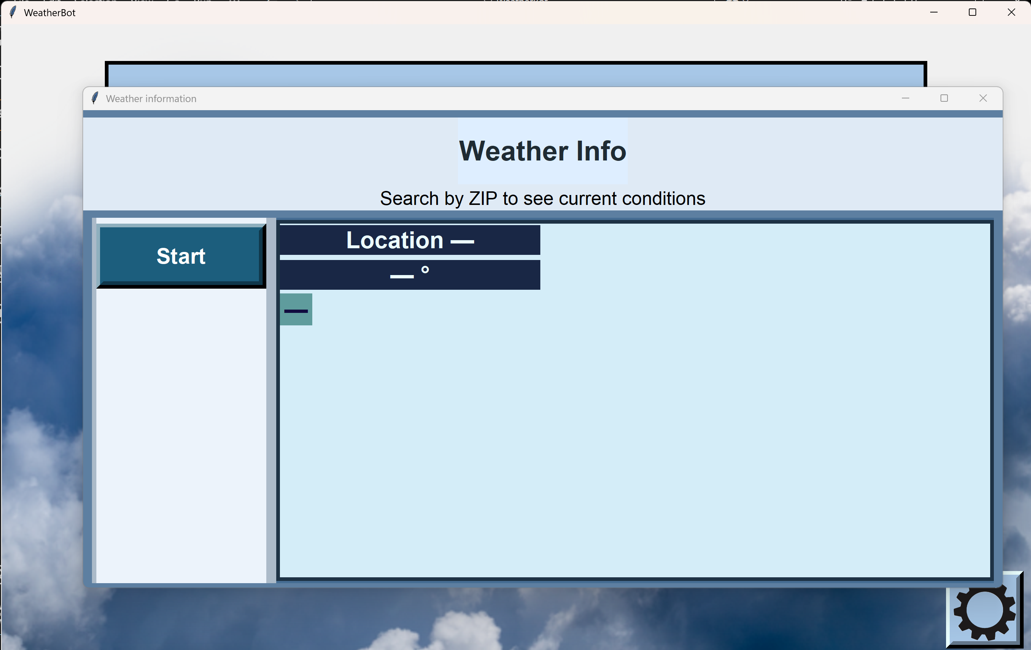
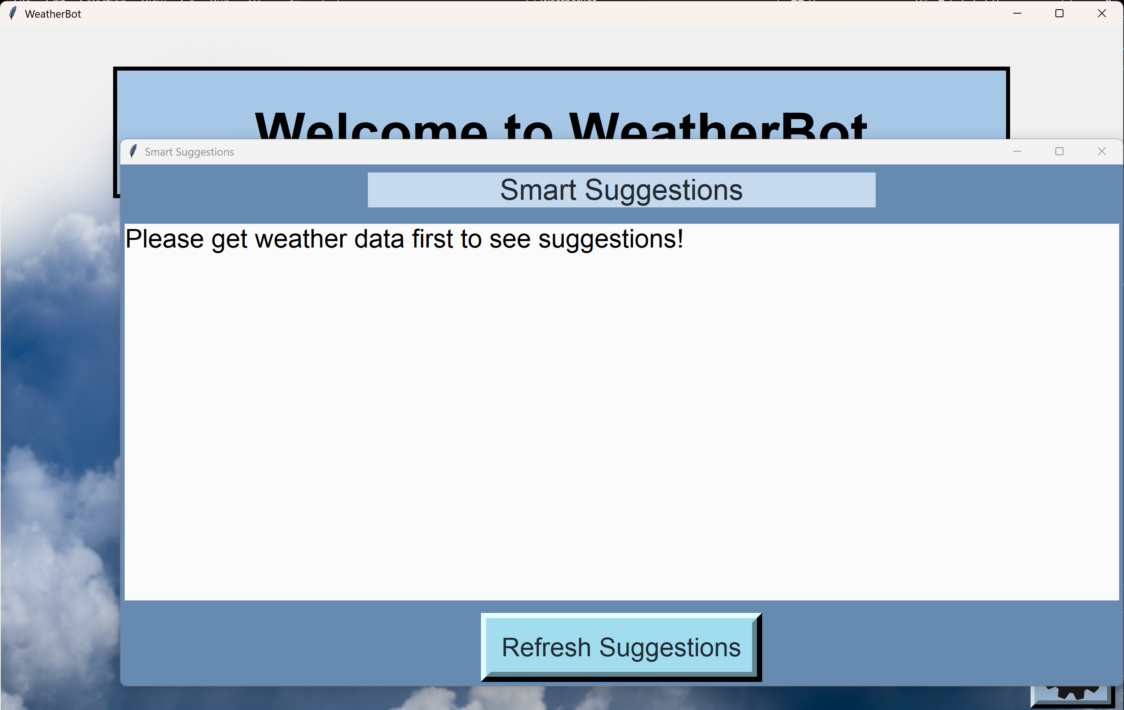

Preview of Software

Slide 7

User Benefits
Weather-Aware Planning
Time and Stress Reduction
Practical Everyday Value
Benefits for every kind of user
Students
Professionals
Families
Elderly

Slide 8

Future Possibilities and Takeaways
Data is everything: A weather software need accurate and reliable forecast
Design Matters: Accessibility isn’t optional it is essential
Iteration creates quality: Each update made WeatherBot more useful
Communication is Key
Fetch global data
Mobile app version
Calendar integration
More personalized suggestions based on routines
More accessibility options like screen reader or voice assistance

Slide 9




THANK YOU! ANY QUESTIONS?

